Slide 1
Chapter 3 : Privacy
Made By:
1-Ahmed Magdy Zaki.
2-Ayman.
3- Ahmed Farag.
4-Ahmed AlaaEldin.
5-Ahmed AbdEllatif Mhana.

Slide 2
Process of transfer data :
1-Information output to information input.
2-Our Personal data is Lifeblood.
3-Safety of Our Information.

Slide 3

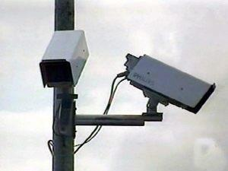
Some People have tendency to invade the privacy of other:
1-Ways :
2-The Problem of privacy violation

Slide 4
1-Conflict between the needs and expectation.
2-The instrumental treatment of human beings and the problem of human freedom.

Slide 5

Privacy Concepts :
:Primary Privacy Rights(SIRA)
1- Solitude
2-Intimacy
3- Reserve
4- Anonymity

Slide 6
Privacy Types:

Slide 7
Location
Territorial
Communication
Information
Bodily
Personal
Person
Location (GPS)
Environment
Person
Person
Communications Methods(Mail-Telephone)
Person& Groups
Information Types
Person
Physical & Information
Person
Body (Drugs-Surveillance)

Slide 8
Related Privacy Issues:
Privacy & Politics:
Politics has violated the privacy of Individuals Through History in order to control public opinion and achieve political goals.
Privacy & Security:
As Privacy gives people the right to remain anonymous and hidden it has been used by Immoral ways.

Slide 9
Privacy & Public Security:
“Humans are just cause they are Enforced to be”by(Glaucon)
According to this quote and the fact that privacy has been used in an immoral way public security has to cross the thin line between it and privacy in order
to keep stability (Used by governments and security agencies).
Public Security
Privacy
Public Security
Privacy

Slide 10
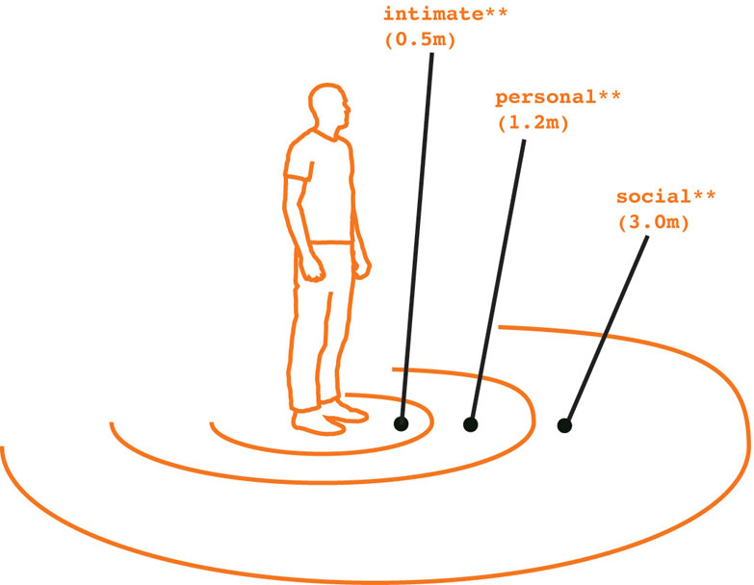
Personal Space:
The Person must be given space where he can do actions as long as it’s not harming anyone. The lack of this personal space gives the person uncertainty and the feeling of insecurity like he is always being watched.

Slide 11
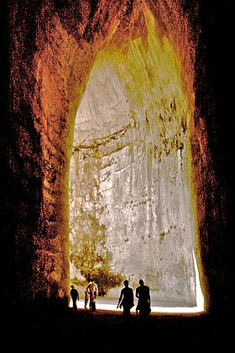
Cave of Dionysius:

Slide 12


Methods Of Privacy Violation

Slide 13
intrusion
misuse of information
interception of information
data mining
data matching

Slide 14
Intrusion:
1-wrongful entry .
2- seizing .
3- acquiring possession of property that
belongs to another.

Slide 15
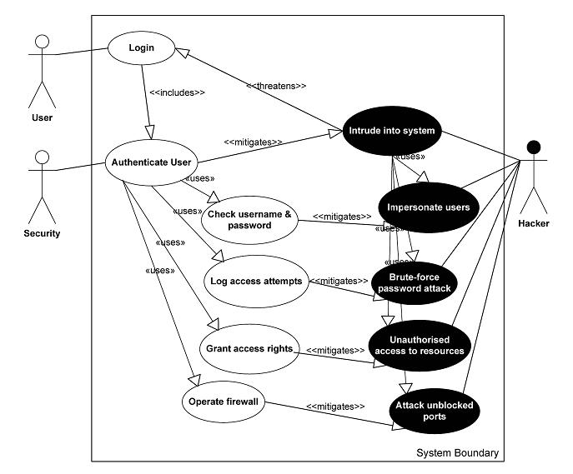
Misuse of in information:
1- illegal use of information .
Intercaption of information:
1-unauthorised access to private information or connection by eavesdropping.
2-unauthorised access by third party to a private connection .

Slide 16
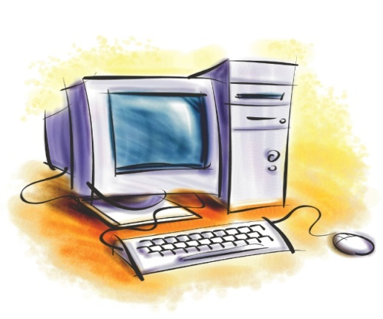

Data matching:
Data combined and linked and compared from two or more databases to produce a new information.
It aims to : Retrieve statistical information or create computer profiling .

Slide 17
Computer profiling:
Combining different data collection to determine people preferences or behaviors .
The whole process of data matching is also related to secondary use of personal information .
( use information for a purpose other than the one for which it was supplied)
used by :
1-Tax agencies.
2-Security agencies.

Slide 18
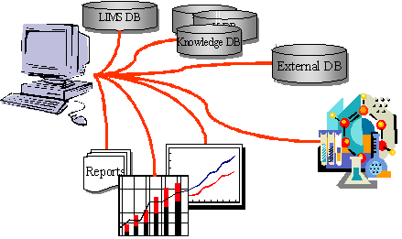
Data mining:
The compiling of masses of data into one or more database in order to extract new information and knowledge that previously hidden or unidentified (KDD) .

Slide 19
:Used for
1-Allowing marketers to combine various criteria .
2-Used by commercial companies to determine how customers have spent their money .

Slide 20
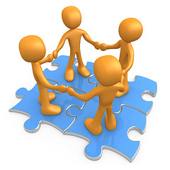

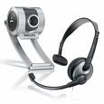

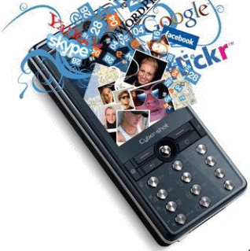

new networks technology:
1-Internet.
2-Computer.
3- Video.
4-Cameras.
5-Satellites.
helps for :
1-Transmit.
2-Share.
3-Merge.

Slide 21
6 Types Of Surveillance Technologies
1-Database Surveillance.
2-Internet Surveillance.
3-Video Surveillance.
4-Satellite Surveillance.
5-Mobile Surveillance.
6-ID Cards Surveillance.

Slide 22
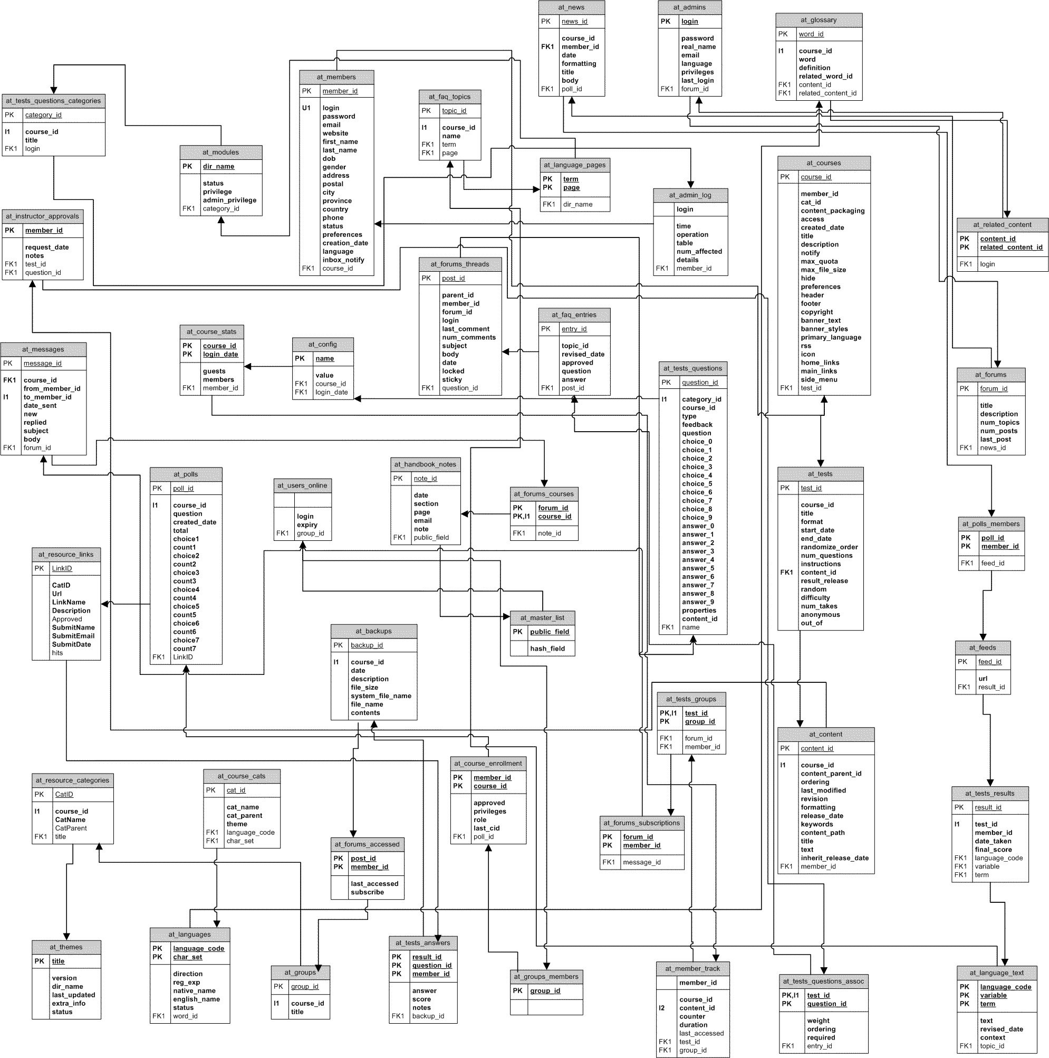
Database Surveillance:
:Problems of database
Privacy is threatened:
1 -Black-list databases
2 - Database mismanagement
3 - Data theft

Slide 23
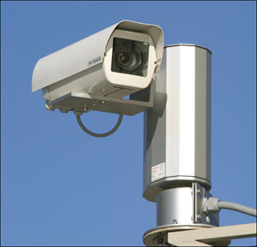
Internet Surveillance:
1-Many website don’t have a good security
2-Other websites uses cookies
3-E-mail

Slide 24
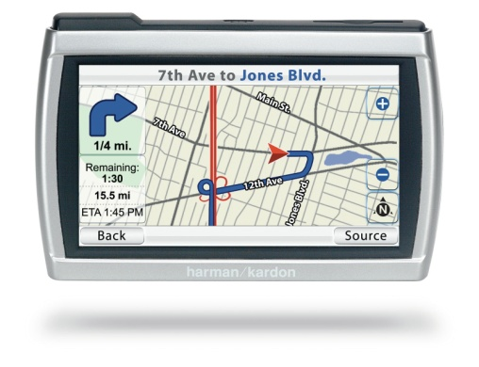
Satellite Surveillance:
Satellites can be used to take photographs of the earth for scientific purpose
BUT, it also take images of our personal life
although the federal government used these photos in order to detect criminals
But, it also threatening out personal privacy.

Slide 25
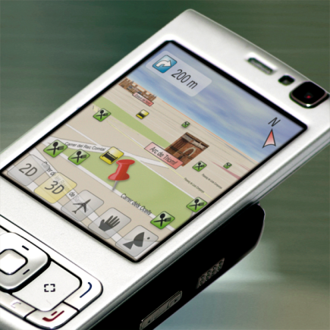
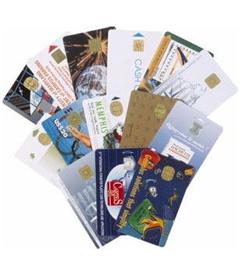
Mobile Surveillance:
ID Cards Surveillance:

Slide 26
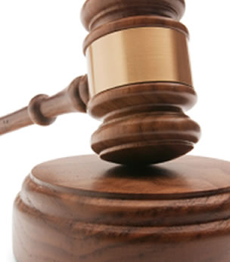
Protecting Privacy:

Slide 27
protection of the privacy of personal data
Data concerning an individual
Data owned by an individual

Slide 28
We should be aware of some questions:
1. Collection of Data : who ? What method & is it transparent and legal?
2. Integrity of Data : is storage accurate ?how : updating , checking, correcting ?
3. Access of Data : Can Access, Change, Correct, know the use of own data ? Sharing private data ? Who controls data ?
4. Protection of Data : is secured ? & how ? Is data protected as law see’s ? What are individual’s right in case of breach?

Slide 29
European Union
United States
Movements of some governments
(Legislations)
Australian
Let us survey some of the countries Legislations through time .

Slide 30
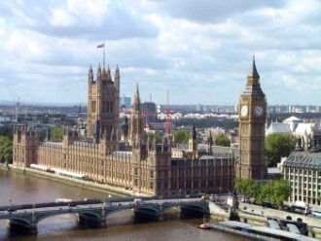

UK Parliament:
UK Parliament ( 1998 ) …. Data Protection Act.
Specifies in Sensitive personal data ( religion , health , … ) .Part 1 of the act defines eight data protection principles .This Act Presents importance of Securing data reliability and privacy in the E.U .

Slide 31


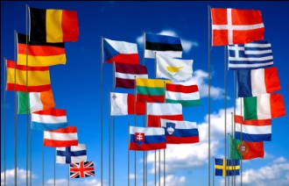
European Union Legislation:
1-1950 European Convention Declaration .
Privacy : Fundamental Human Right .
2-OECD ( 1980 ) : Guide lines for the protection and privacy of transporter flows of personal data .

Slide 32

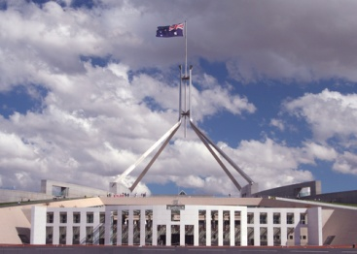
Australian Legislation
Australian Federal Government ( 1984 ) .
Statement by the independent Australian Privacy charter council .

Slide 33
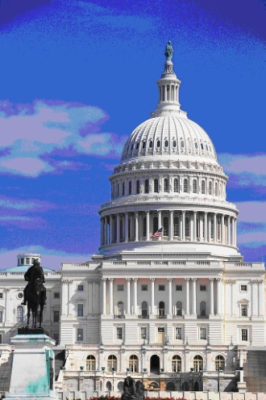
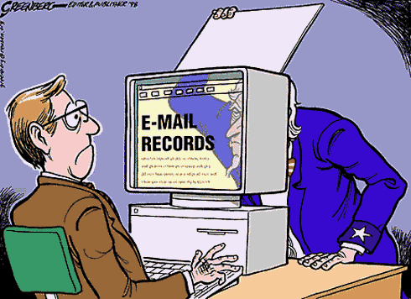
United States Legislation:
U.S Legislation …. Special Case .
First & Forth Amendments to the U.S Constitution .
Two Central Laws of Personal data in U.S Privacy Legislation .

Slide 34

THANKS FOR YOUR ATTENTION

